Slide 1
Glossary. Read and guess the meaning of the words in bold:
aquatic (adj): | living or growing in, happening in, or connected with water.
blockbuster (n): | a book, film, etc that is very popular and successful.
epic (n): | a story or film which is very long and contains a lot of action.
Ernst Blofeld: | the villain in some James Bond films.
Lex Luther: | the villain in Superman.
found (v): | to start an organization, especially by providing money.
household name : | someone or something that everyone knows.
mar (v): | to spoil something.
paddling pool (n): | a shallow pool that small children can play in.
polar (adj): | relating to the North or South Pole.
status quo (n): | the situation that exists now, without any changes.
tarmac (n): | a thick, black substance that is sticky when hot and is used to cover roads.
toxic (adj): | poisonous.

Slide 2
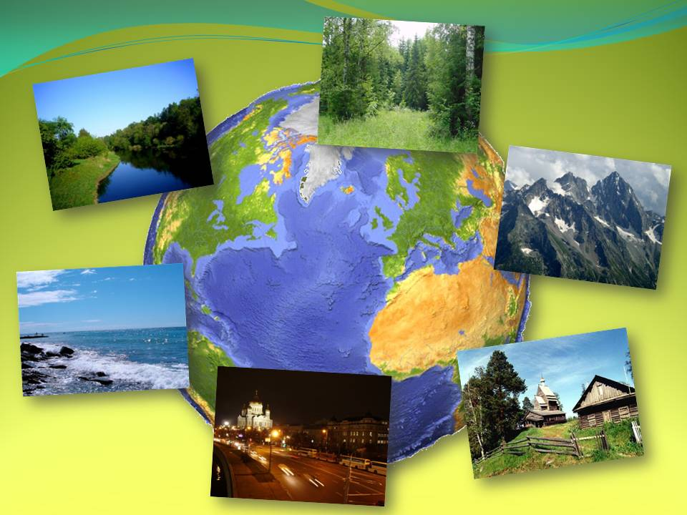

Slide 3
Listen to the text and fill the gaps:
1) However, many people feel that the governments of countries around the world are not taking environmental issues ……..
2) Human and toxic……… pumped into the sea was causing serious……., and beach goers felt that they were “playing Russian Roulette with their health” every time they went into the water.
3) Reclaim The Streets was started in London in 1991 to campaign “FOR………., cycling and cheap, or free, ………transport, and AGAINST cars, roads and the system that………. them.”
4) “The Reclaim The Streets idea has………. and left home, street parties and suchlike often happen without anyone in RTS London hearing about them until afterwards.” 5) It seems that nowadays the Internet is helping more and more people express their dissatisfaction with the status quo, and work……….. to find………… to the problems that the modern world faces.

Slide 4
Comprehension task Read the statements below and decide if they are true or false.
1. Surfers Against Sewage members like playing with guns.
2. Reclaim The Streets started in Cornwall.
3. The people who started Surfers Against Sewage like water sports.
4. RTS demonstrations are always peaceful.
5. The SAS organization has been very successful.
6. Reclaim The Streets is against road building.
7. The SAS logo appeared in the film "The Beach".
8. RTS events sometimes attract thousands of people.

Slide 5
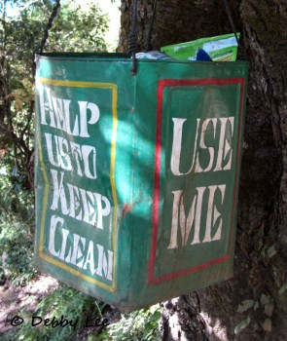
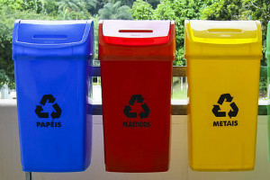
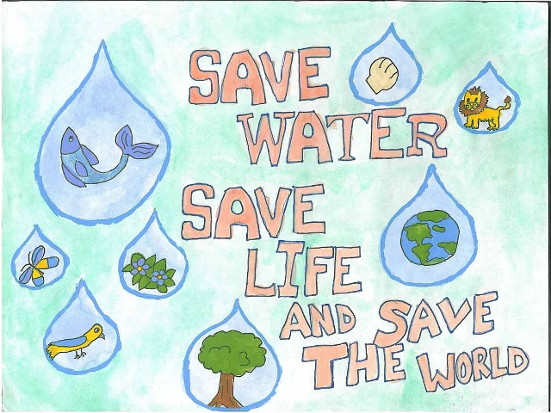
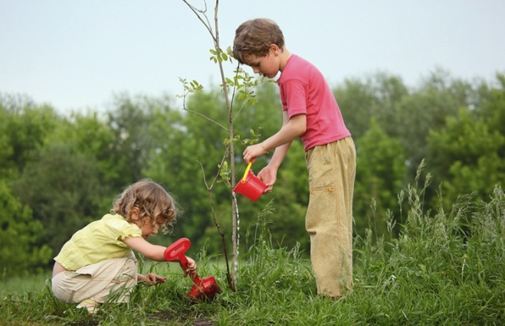
Work in pairs. Write down 3-4 sentences what can you do to solve the environment problems, using the modal verbs must, mustn’t, can, be able to.

Slide 6
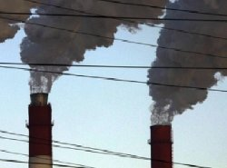
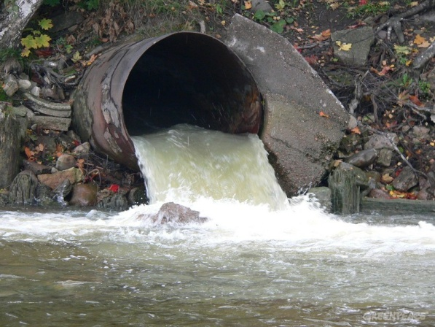
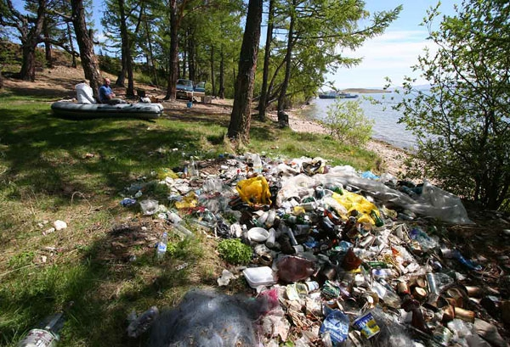
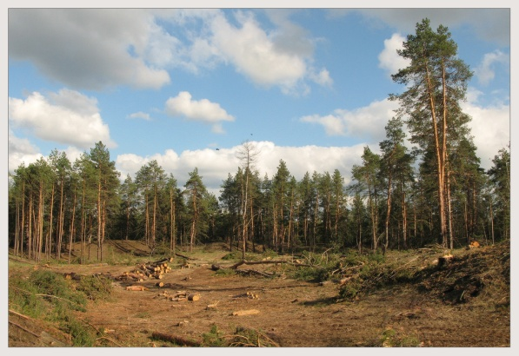
Now answer the questions:
1) Are there any environment
problems in our region, town?
2)What problems can you name?

Slide 7
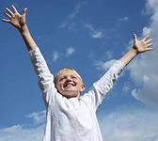
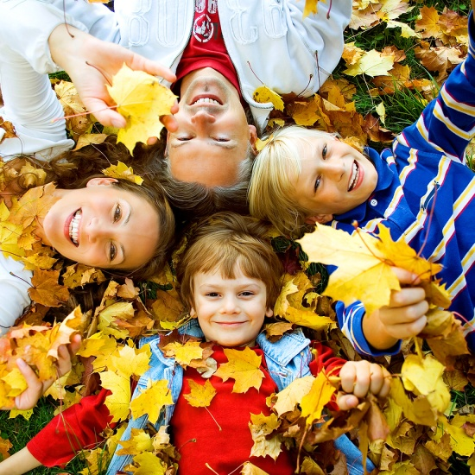
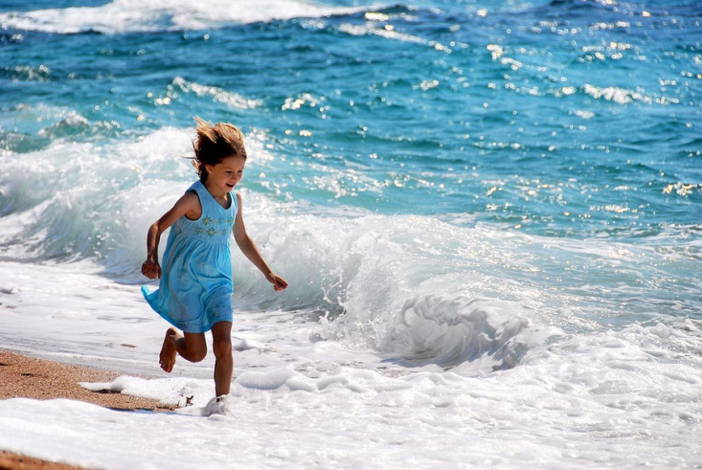
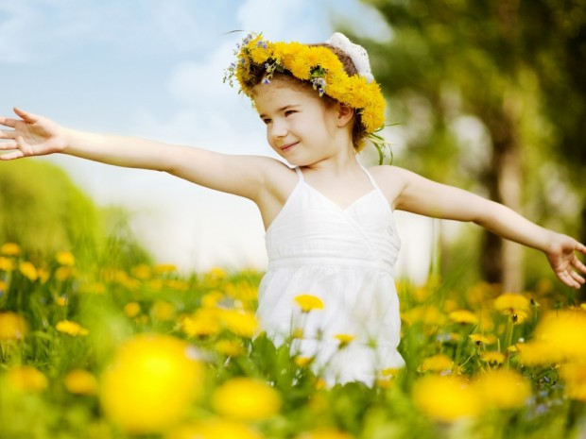
Love and protect our planet!

